Slide 1
Review of existing guidance on costing
Sedona Sweeney
London School of Hygiene and Tropical Medicine

Slide 2
Introduction
Objectives of this study
  To provide a bibliometric overview of existing guidance on costing methods
  To identify evidence to draw upon in development of the reference case

Slide 3
Costing Tools – not included in the review
HIV tools
Goals
Resource Needs Module
Decision-Makers’ Program Planning Tool (DMPPT)
Future ART Costs
PMTCT
Optima
ASAP HIV/AIDS Costing Tool
VCT Costing checklist
AIDS Impact Model for Business (AIM-B)
Antiretroviral Therapy Unit Cost Spreadsheet
HIV Testing and Counseling Service Delivery Costing Model (HSDC)
Key Populations Costing Workbook
Medication-Assisted Therapy Costing Worksheet
PMTCT and Pediatric ART Costing Tools (PMTCT/Peds)
TB tools
TB Impact Model and Estimates (TIME)
Planning and Budgeting for TB
Other tools
DemProj
AIDS Impact Mode (AIM)
Lives Saved Tool
OneHealth Tool
Marginal Budgeting for Bottlenecks
Integrated Healthcare Technology Package (iHTP)
Costing and Financing Tool for Childhood Immunization
Integrated Health Model
Pipeline Monitoring and Procurement Planning
Supply Chain Manager
ProQ Quantification Software for HIV Tests
Assessment tool for Laboratory Services and Supply Chains Database (ATLAS)
Cost Revenue Analysis Tool
Reproductive Health (RH) Costing Tool
Planning, Costing and Budgeting Framework (PCBF)
CORE Plus
Notes:
Some of these have cost models linked to them
We exclude tools because this is about actual data collection rather than coming to a cost estimate.

Slide 4
Search Strategy
Database | Search terms
Pubmed | "costing"[Title/Abstract] OR "cost collection"[Title/Abstract] or "cost estimation"[Title/Abstract]) AND (method$ or methodology OR validity OR generalizability OR comparison OR approach OR standard$ OR guideline$ OR recommendation$)
Econlit | ("costing" or (cost adj collect*) or (cost adj estimat*) or (cost adj measur*) or (cost adj valu*) or (cost adj calculat*) or (cost adj analys*)).mp. (method$ or methodology or valid* or generalizab* or compar* or approach* or standard$ or guideline$ or recommendation$ or accura* or bias).mp. (HIV or "human immunodeficiency virus" or AIDS or "advanced immune disease syndrome" or TB or tuberculosis or malaria or immuniz* or vaccinat* or disease* or ill* or health* or treat* or care or medic*).mp. 1 and 2 and 3
Global Health | ("costing" or (cost adj collect*) or (cost adj estimat*) or (cost adj measur*) or (cost adj valu*) or (cost adj calculat*) or (cost adj analys*)).mp. (method$ or methodology or valid* or generalizab* or compar* or approach* or standard$ or guideline$ or recommendation$ or accura* or bias).mp. 1 and 2
Embase | (("costing" or "cost collection" or "cost estimation" or "cost measurement") adj (method$ or methodology or valid* or generalizab* or compar* or approach* or standard$ or guideline$ or recommendation$ or accura* or bias)).mp.

Slide 5
Search Strategy
Pubmed
2638 results, of which 255 selected for abstract review
Econlit
387 results, of which 55 selected for abstract review
Global Health
2224 results, of which 64 selected for abstract review
Embase
682 results, of which 140 selected for abstract review
514 papers downloaded
23 duplicates removed
491 papers retained
DIRUM resource: methodological papers
18 additional papers included
172 irrelevant papers excluded:
unrelated to health care costs: 43
focus is economic evaluation rather than costing: 11
no discussion of costing methods: 117
Erratum of previous paper: 1
18 papers for which abstract was unavailable
Abstract review:
477 papers reviewed
Snowball sampling and manual searches for unpublished literature:
62 additional papers included
Extraction:
331 articles extracted

Slide 6

When has guidance been published?

Slide 7
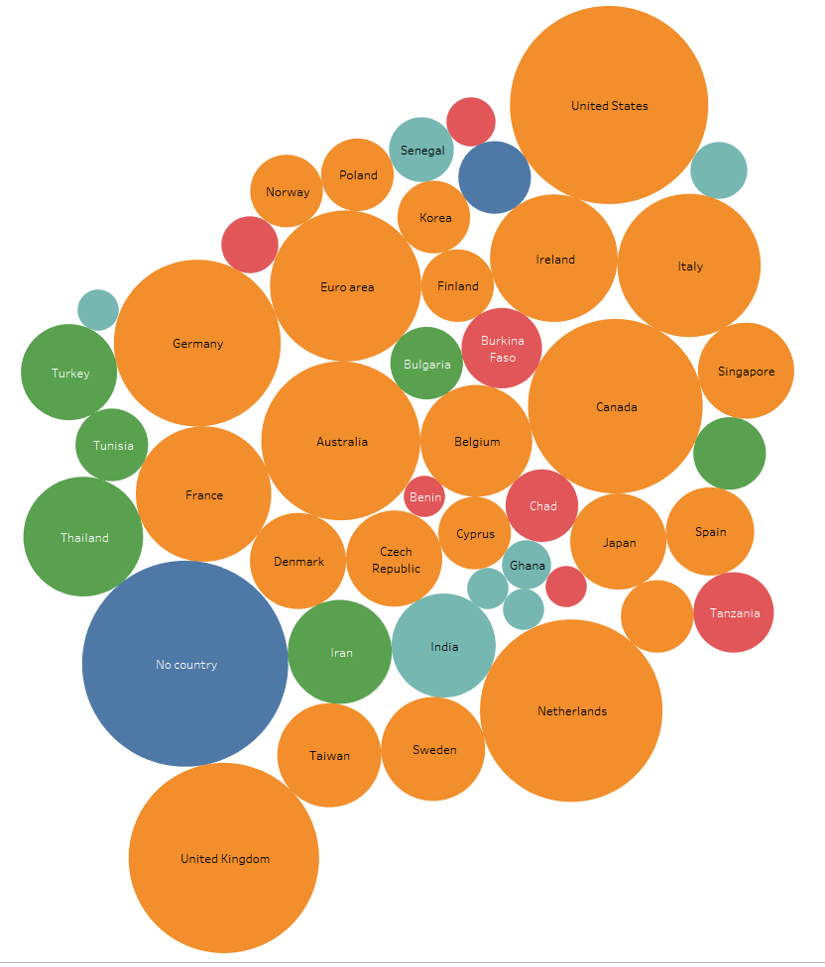
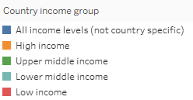
What countries/ areas does the existing guidance concern?
Notes:
Looking at the geography that the guidance concerns, 155 of the 450 were not country specific, aimed at an international audience. As you can see most of the records which are relevant to a specific setting refer to high-income countries in the orange. 22 of the 450 focused on a low or lower-middle income country.

Slide 8
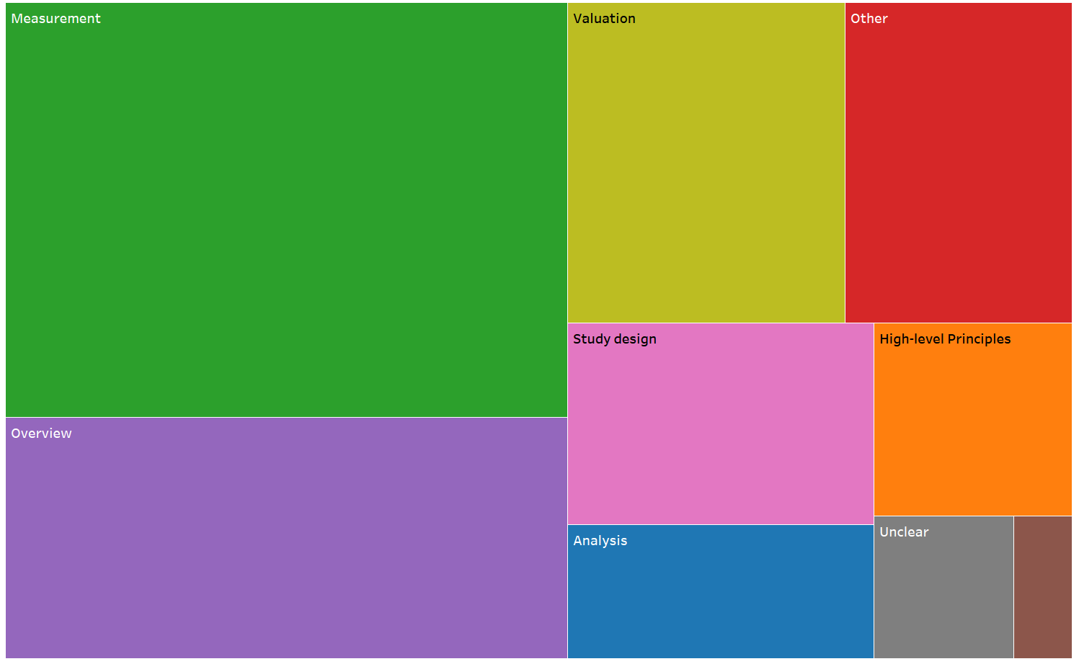
What types of issues are addressed by current guidance?
Notes:
Looking at what types of issues are addressed by the current guidance, we see that about a third of the references give some guidance on measurement of quantities, for example number of visits to a health provider. About 20% are overview guides to costing, most of these are disease-specific. About 15% refer to valuation and just under 10% refer to study design (things lke sampling, selection, etc).

Slide 9
Does any analysis underlie guidance?
Empirical comparison / validation
Case study / worked example
Other analysis
No analysis

Slide 10
What diseases are covered?

Slide 11
HIV and TB-specific guidance
HIV
First Author | Year | Title
Beck | 2012 | Counting the cost of not costing HIV health facilities accurately: Pay now, or pay more later
Beck | 2013 | Costs and cost-effectiveness of HIV community services: Quantity and quality of studies published 1986-2011
Beck | 1999 | What is the cost of getting the price wrong?
Korthuis | 2002 | Do interviews agree with medical record and pharmacy data?
Kumaranayake | 2000 | Costing guidelines for HIV prevention strategies.
Kumaranayake | 2008 | The economics of scaling up: cost estimation for HIV/AIDS interventions
Lim | 1994 | An economic analysis of AIDS--towards a proposed model of costing: a Singapore experience
NASA | 2009 | Guide to produce National AIDS Spending Assessment (NASA)
Over | 1989 | Guidelines for rapid estimation of the direct and indirect costs of HIV infection in a developing country
Over | 2012 | HIV Treatment as Prevention: Modelling the Cost of Antiretroviral Treatment—State of the Art and Future Directions
Phillips | 2001 | A Step-by-step Methodological Guide for Costing HIV/AIDS Activities
Shrestha | 2012 | Comparison of methods for estimating the cost of human immunodeficiency virus-testing interventions
Telyukov | 2000 | Design and Application of a costing framework to improve planning and management of HIV/AIDS programs
Tolley | 1993 | The treatment and care costs of people with HIV infection or AIDS: development of a standardised cost framework for Europe
UNAIDS | 2000 | Costing Guidelines for HIV prevention strategies
UNAIDS | 2011 | Manual for costing HIV facilities and services
Weissman | 1996 | The validity of self-reported health-care utilization by AIDS patients
TB
First Author | Year | Title
Cunnama | 2016 | Using Top-down and Bottom-up Costing Approaches in LMICs: The Case for Using Both to Assess the Incremental Costs of New Technologies at Scale
KNCV | 2008 | Tool to estimate patients' costs
Oxlade | 2013 | How Methodologic Differences Affect Results of Economic Analyses: A Systematic Review of Interferon Gamma Release Assays for the Diagnosis of LTBI
Sohn | 2009 | TB diagnostic tests: how do we figure out their costs?
WHO | 1999 | Generic protocols for cost and cost-effectiveness analysis of tuberculosis diagnosis and treatment services

